Slide 1


SHIELD INSURANCE
Strong overall growth, with business concentrated in Delhi NCR and the 26–35 segment while sales mix shifts toward digital.
₹989M
26,841
₹5.47M
TOTAL REVENUE
TOTAL CUSTOMERS
DAILY REVENUE
KEY BUSINESS TAKEAWAYS
1
SALES MIX IS SHIFTING TOWARD DIGITAL
Offline-Agent remains the largest channel, but its share is declining while digital channels gain share.
2
REVENUE AND CUSTOMER BASE EXPANDED STRONGLY
3
DELHI NCR IS THE LARGEST MARKET
4
26–35 IS THE CORE CUSTOMER SEGMENT
Revenue reached ₹989M and customers reached 26,841, both up approximately 18% vs last month.
₹402M revenue from 11,007 customers — highest among cities.
9,168 customers and ₹250M revenue — the largest age segment.

Slide 2





SHIELD INSURANCE
THE ANALYSIS WAS DESIGNED TO ANSWER THE KEY QUESTIONS DRIVING REVENUE, CUSTOMER, MARKET AND CHANNEL DECISIONS.
KEY ANALYTICAL FRAMEWORK
BUSINESS PERFORMANCE
How many customers and
how much revenue are we generating?
CUSTOMER PROFILE
What does our customer base look like?
MARKET PERFORMANCE
SALES CHANNELS
Which cities and age groups drive the business?
Which sales modes drive revenue and customers?
CUSTOMER BEHAVIOR
How do settlement, policy and sales-mode
preferences vary by age group?

Slide 3




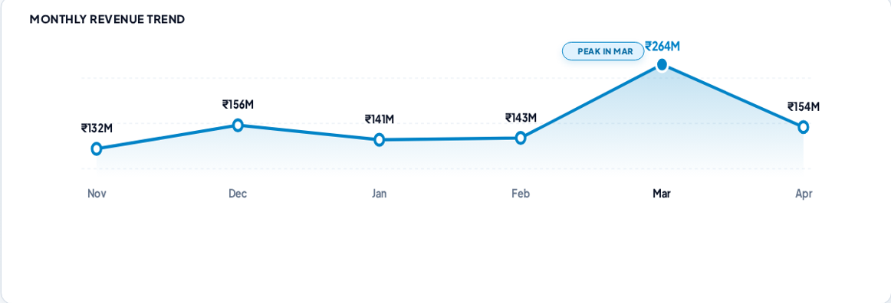
SHIELD INSURANCE
REVENUE AND CUSTOMER BASE GREW STRONGLY, BUT DAILY PERFORMANCE SOFTENED SLIGHTLY IN THE LATEST MONTH.
₹989M
26,841
₹5.47M
148.29
TOTAL REVENUE
TOTAL CUSTOMERS
DAILY REVENUE
DAILY CUSTOMERS

Slide 4
CUSTOMER & MARKET
SHIELD INSURANCE
DELHI NCR IS THE LARGEST MARKET, WHILE THE 55+ SEGMENT CONTRIBUTES DISPROPORTIONATELY TO REVENUE.
CITY PERFORMANCE
AGE GROUP PERFORMANCE
Delhi NCR
₹402M
AGE GROUP | CUSTOMERS | REVENUE
18–25 | 13.3% | 5.4%
26–35 | 34.2% | 25.3%
36–45 | 28.9% | 27.5%
46–55 | 10.8% | 14.2%
★ 55+ | 12.8% | 27.8%
Mumbai
₹240M
Hyderabad
₹161M
Chennai
₹106M
Indore
₹81M
💡 55+ generates 27.8% of total revenue from only 12.8% of customers, alongside the highest average premium.
DELHI NCR: TOP MARKET
11,007 Cust.
₹402M Rev.

Slide 5


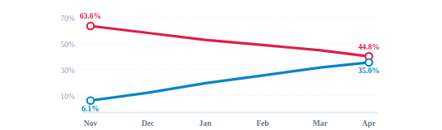
SHIELD INSURANCE
Offline-Agent remains the largest sales mode, but its share is declining steadily as digital channels gain ground.
MONTHLY SALES MODE TREND
CURRENT REVENUE MIX
Offline-Agent 55.67%
Online-App 16.27%
Offline-Direct 15.46%
Online-Website 12.60%
CHANNEL SHIFT (NOV-22 VS APR-23)
63.6% 44.8%
Digital (App + Website)
Offline-Agent
6.1% 35.0 %

Slide 6
CUSTOMER BEHAVIOR
SHIELD INSURANCE
CUSTOMER VALUE INCREASES WITH AGE: 55+ HAS THE HIGHEST AVERAGE PREMIUM AND EXPECTED SETTLEMENT RATE, WHILE 26–35 REMAINS THE LARGEST CUSTOMER SEGMENT.
CUSTOMER SEGMENT SIZE
CUSTOMER VALUE & SETTLEMENT
26–35
9,168
34.2%
AGE GROUP | AVG PREMIUM | SETTLEMENT
18–25 | ₹14,897 | 38.14%
26–35 | ₹27,219 | 48.72%
36–45 | ₹35,074 | 57.90%
46–55 | ₹48,187 | 62.78%
★ 55+ | ₹79,635 | 71.98%
36–45
7,755
28.9%
18–25
3,563
13.3%
55+
3,447
12.8%
46–55
2,908
10.8%

Slide 7
RECOMMENDATIONS & NEXT
SHIELD INSURANCE
PRIORITIZE DIGITAL GROWTH, PROTECT HIGH-VALUE CUSTOMERS, AND DEEPEN THE STRONGEST MARKETS AND SEGMENTS.
01
CHANNEL
02
CUSTOMER VALUE
03
MARKET
ACCELERATE DIGITAL
PROTECT & GROW 55+
DEEPEN CORE MARKETS
Use the strong upward movement in Online-App and Online-Website share to expand digital adoption while maintaining Offline-Agent as an important channel.
The 55+ segment combines the highest average premium (₹79,635) with the highest expected settlement rate (71.98%). Prioritize retention and value-focused offerings.
Continue strengthening Delhi NCR as the leading market while using the 26–35 segment, the largest customer group, to drive acquisition and future growth.
EXPECTED BUSINESS OUTCOMES
DIGITAL SCALE
CUSTOMER VALUE
MARKET GROWTH
↑ Reach • ↑ Adoption
↑ Retention • ↑ Value
↑ Penetration • ↑ Acquisition
Data note: Policy preference is represented by policy IDs, while settlement data is available at age level without a time dimension.

Slide 8

SHIELD INSURANCE
THANK YOU
Data-Driven Insights for Better Decisions
Questions & Discussion

